Slide 1

Data Exploration and Analysis
on
Mutual Funds
By Subhadwip Manna
Guided by Dr. Aakansha Gupta

Slide 2




Introduction
This project aims to perform exploratory data analysis (EDA) on a mutual fund dataset to gain insights and understand the characteristics of the funds. The dataset contains information on various attributes such as fund type, expense ratio, performance metrics, and fund size. The EDA will utilize descriptive statistics, visualizations, and correlation analysis to uncover patterns, trends, and potential relationships within the dataset. The findings from this EDA will provide valuable information for investors, fund managers, and financial analysts to make informed decisions regarding mutual fund investments.
Here , we used “Jupyter Notebook, Python Language, MySQL and Tableau ” to load, preprocess the data and show some visualisation graphs to get proper insights.

Slide 3
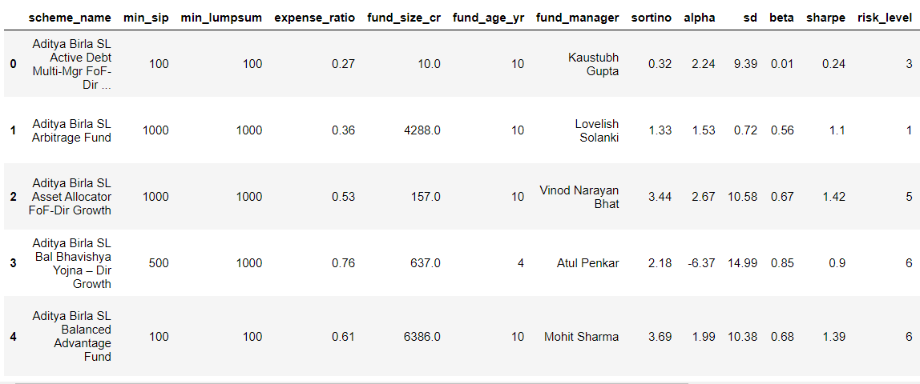
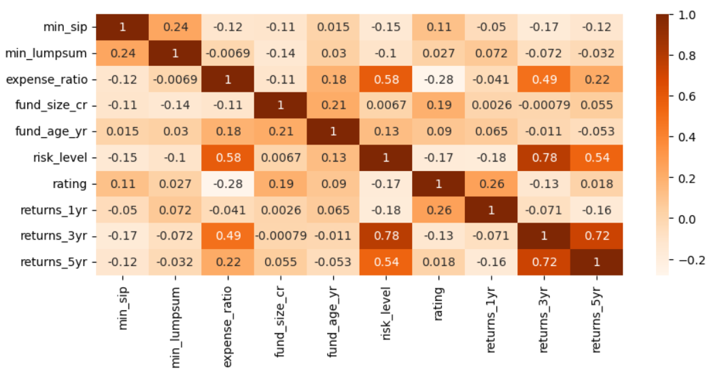
-:EDA:-
Reading data
Missing value treatment
Duplicate records treatment
Outliers treatment
Exploring and error treatments
Data Preprocessing
Data exploring and visualisations
Python
MySQL
Tableau
ML Models
Number of records: 814
Number of features: 20

Slide 4
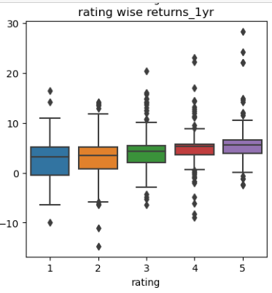
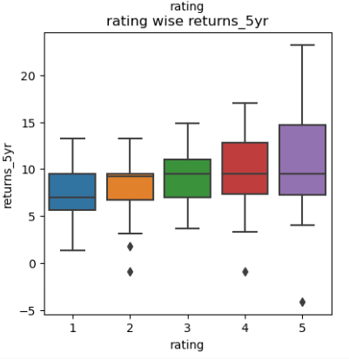
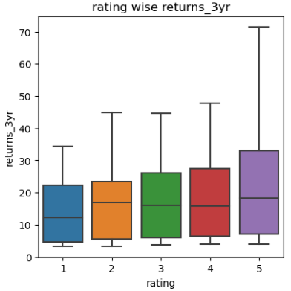
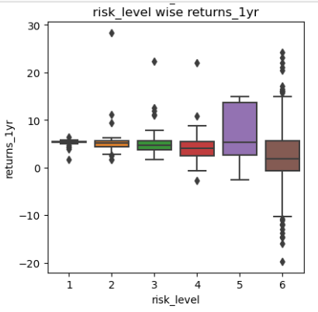
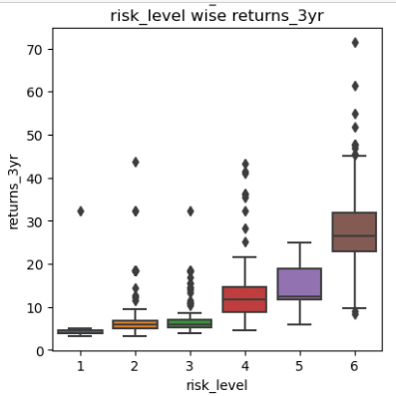
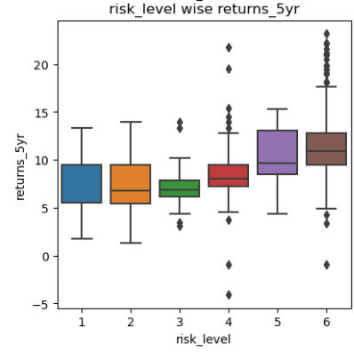
1 YEAR
3 YEARS
5 YEARS
-:Bi-Variate:-
4. High rating fund always return
good in any years.
RATING
Return of 1 year and risk level have very minor opposite correlation
2. Return of 3 years is will be
very good if risk level is high.
Return of 5 years is will be
little good if risk level is high.
RISK LEVEL

Slide 5
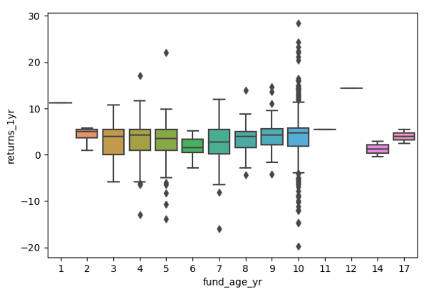
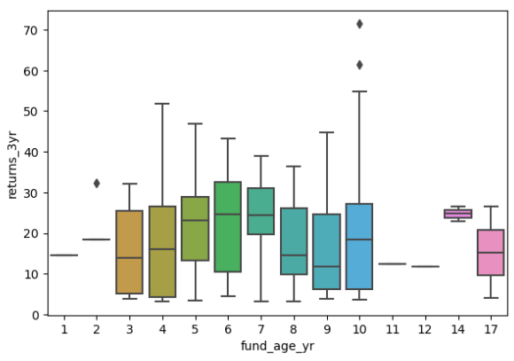
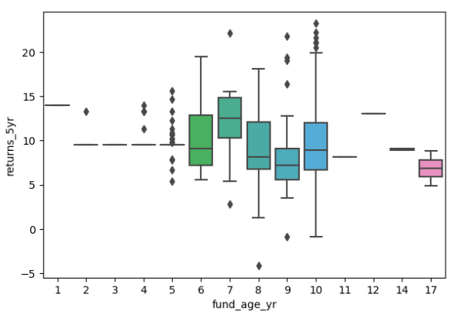
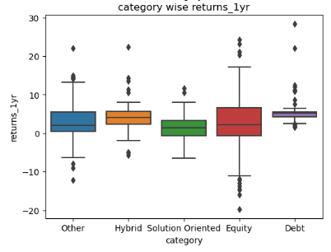
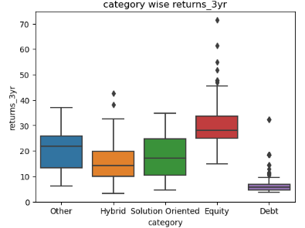
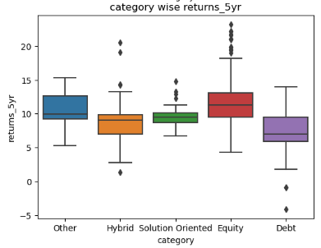
-:Bi-Variate:-
1 YEAR
3 YEARS
5 YEARS
Fund's age does not play any
major role for return in 1 year.
2. If fund's age is 5 to 7 then there
is a minor chance to get good
return in 3 years.
3. For 5 years there is a good
return if fund's age is 7.
FUND AGE
In 1 year all category will give
same returns.
2. In 3 years Equity fund gives
best return, whether debt fund
give very bad returns.
3. In 5 years also Equity fund
gives best and Debt fund gives
less but better than year 3.
CATEGORY

Slide 6
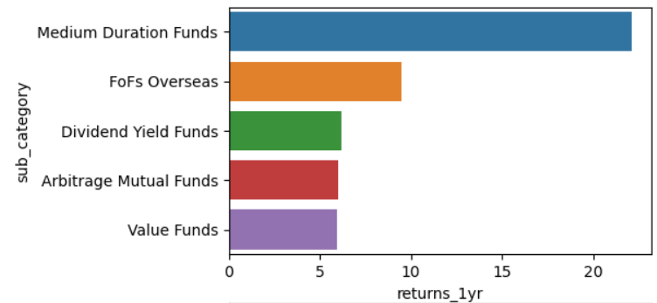
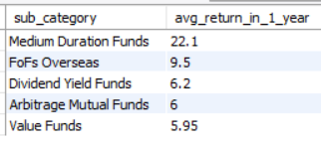
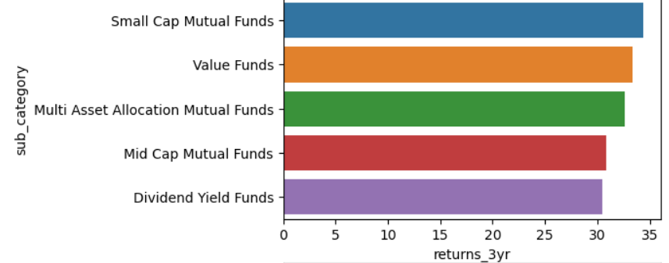
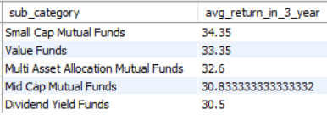
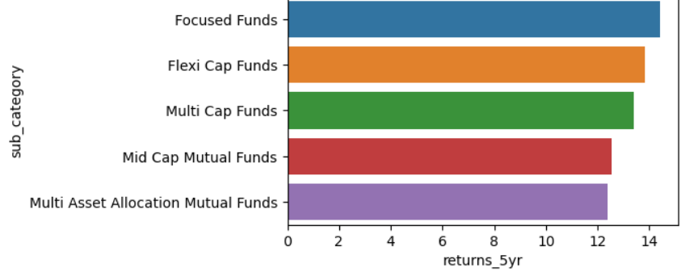
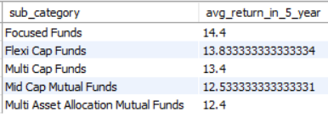
-:Multivariate:-
1 YEAR
Requirement
1. Show top 5 sub-category based on avg return in each year when minimum lumpsum is 1000 and fund's age is more than 4
3 YEARS
Best Sub-category:
1 YEAR :Medium Duration
funds
5 YEARS
3 YEARS :Small Cap Mutual
Funds
5 YEARS :Focused Funds

Slide 7
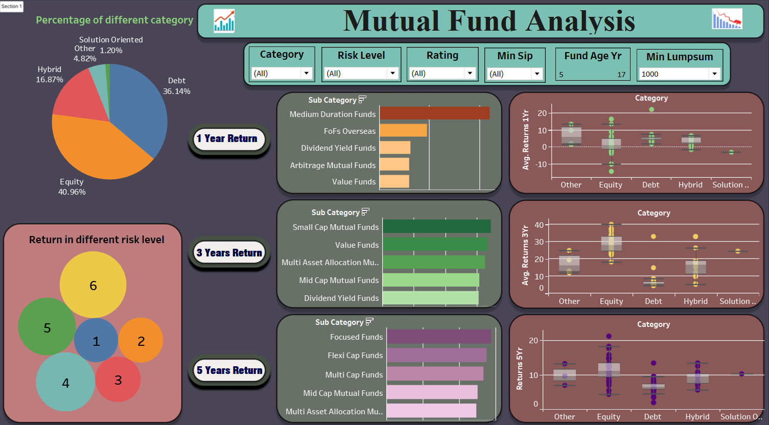

Slide 8
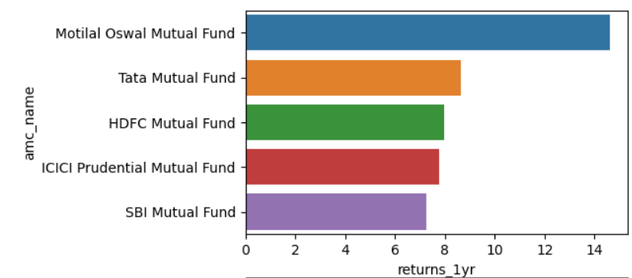
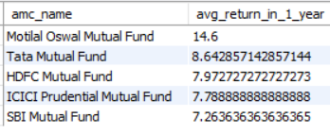
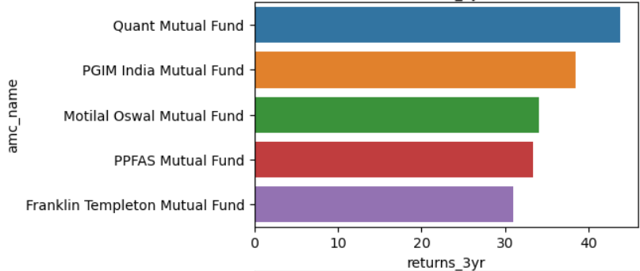
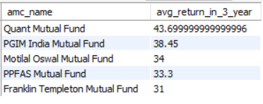
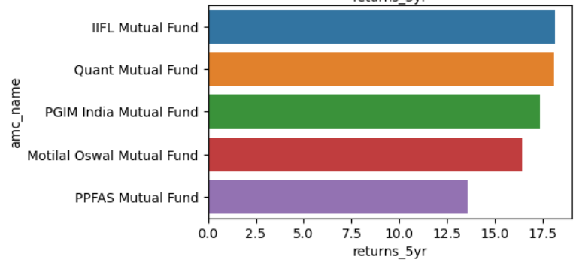
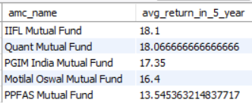
-:Multivariate:-
1 YEAR
Requirement
1. Show top 5 amc_name based on avg return in each year when fund size is more than 1000 and rating is more than 3
3 YEARS
Best AMC:
1 YEAR :Motilal Oswal Mutual
Funds
5 YEARS
3 YEARS :Quant Mutual
Funds
5 YEARS :IIFL Mutual Funds

Slide 9
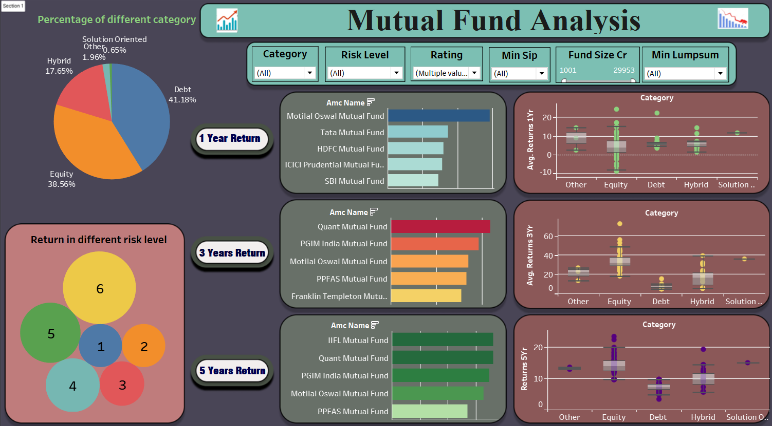

Slide 10
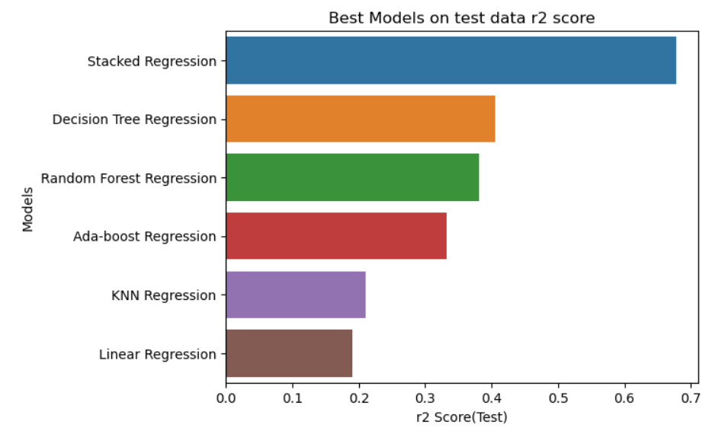
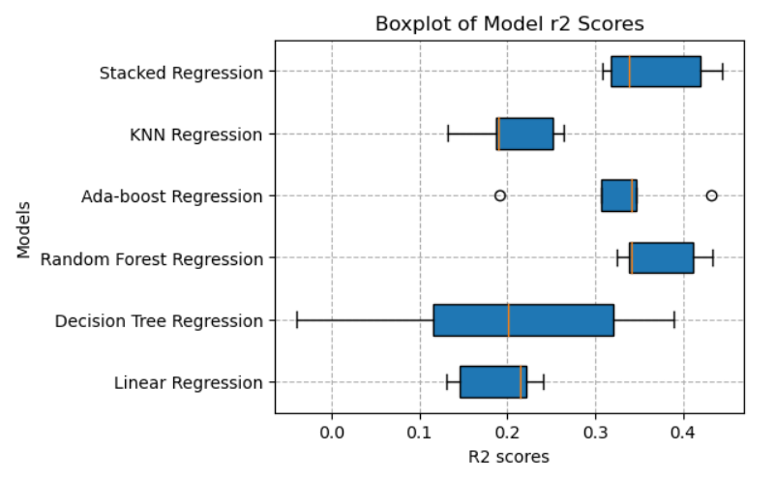
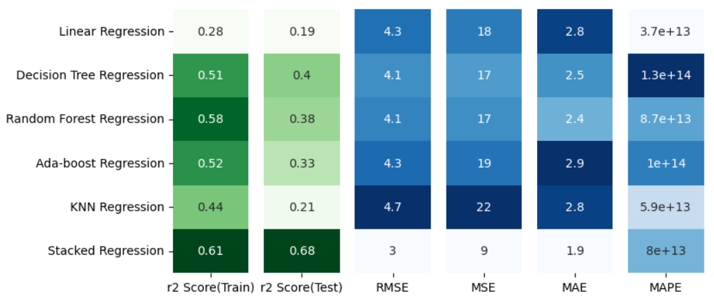
1 Year return
Performance of different Models
R2 Score = Good Fit
Errors = Bad Fit
-:Best Model :-
Stacked Regression Model

Slide 11
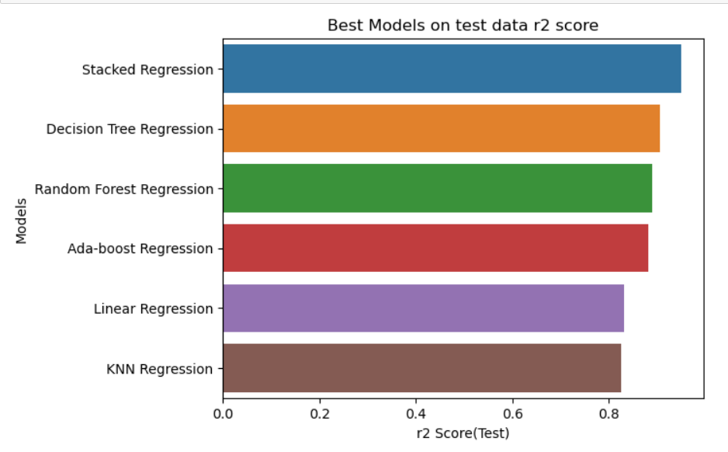
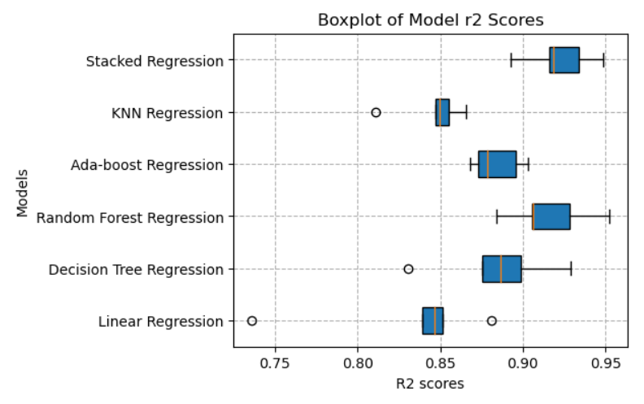
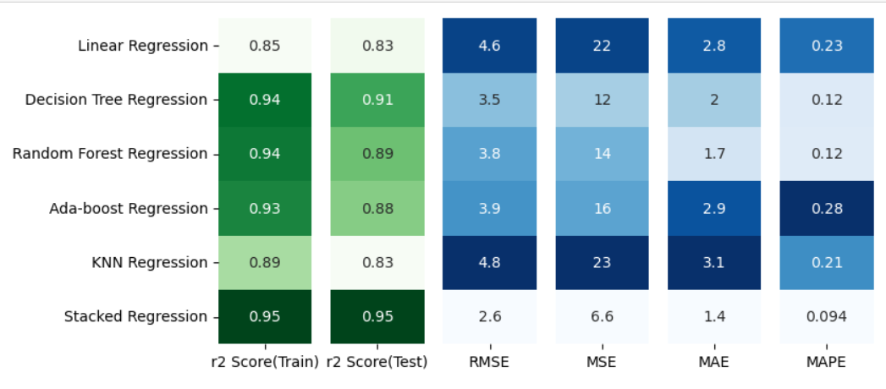
3 Years return
Performance of different Models
R2 Score = Good Fit
Errors = Bad Fit
-:Best Model :-
Stacked Regression Model

Slide 12
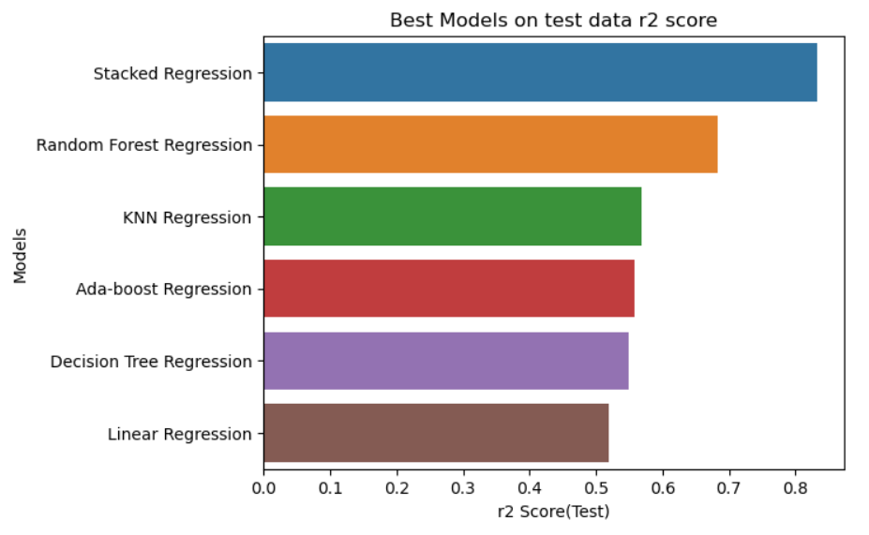
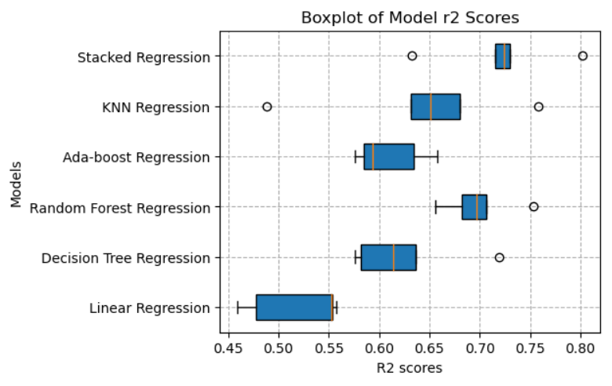
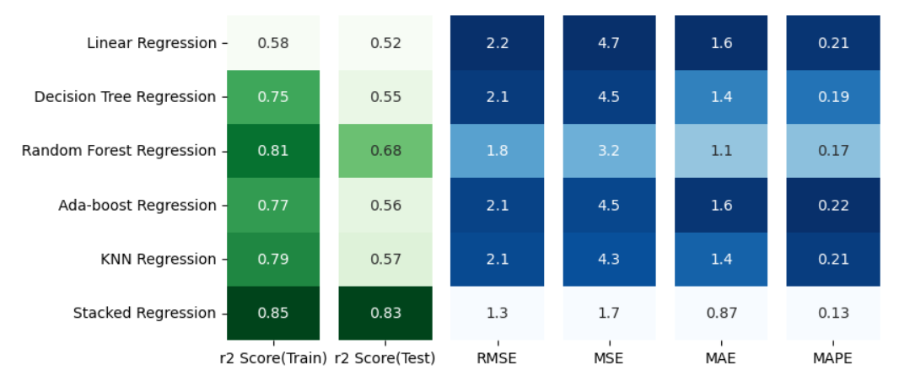
5 Years return
Performance of different Models
R2 Score = Good Fit
Errors = Bad Fit
-:Best Model :-
Stacked Regression Model

Slide 13
Conclusion :
In conclusion, the exploratory data analysis (EDA) on the mutual fund dataset revealed valuable insights. The analysis showcased the distribution of returns in various years . It helps to choose the best category, sub-category and performance metrics of different funds. These findings provide investors, fund managers, and financial analysts with important information for making informed decisions about mutual fund investments. The EDA serves as a foundation for further analysis and decision-making in the field of mutual funds.
The stacked regression model outperformed other models due to its diverse predictions, error correction, feature combination, ensemble learning, hyperparameter optimization, and ability to capture nonlinear relationships.

Slide 14

THANK YOU
Happy investing…
You create your future by what you do in present.
Bangambiki Habyarimana

